Slide 1


Correlation between general health and mental health

Slide 2

Introduction
Indigenous People: 3 categories - First Nations, Inuit, Metis - Original Inhabitants of Canada before European Settlement
First Nations - Live on Reserve Land provided from Canadian Government [5, 2] registered under Indian Act
Metis - Mixed people of European and First Nation Descent [1]
Inuit - Inhabitants of Nunavut, Quebec, NFL, Northwest Territories [6]
Focus on who are individuals facing problems in mental health
Issues faced in 2 Categories
Indigenous Descent: From the 3 categories of Indigenous People
Housing: Need for repairs
Impact of Indigenous Descent and Housing on Mental Health

Slide 3
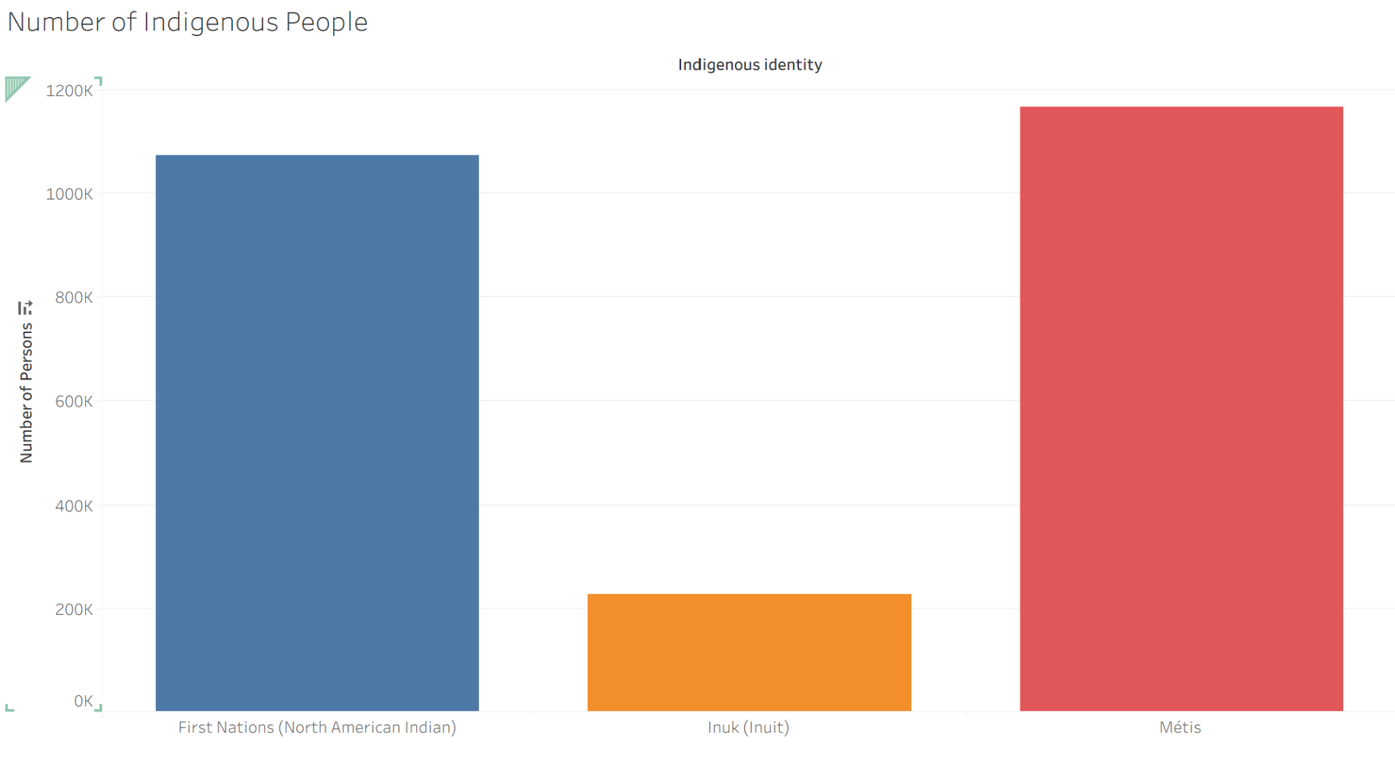

Slide 4
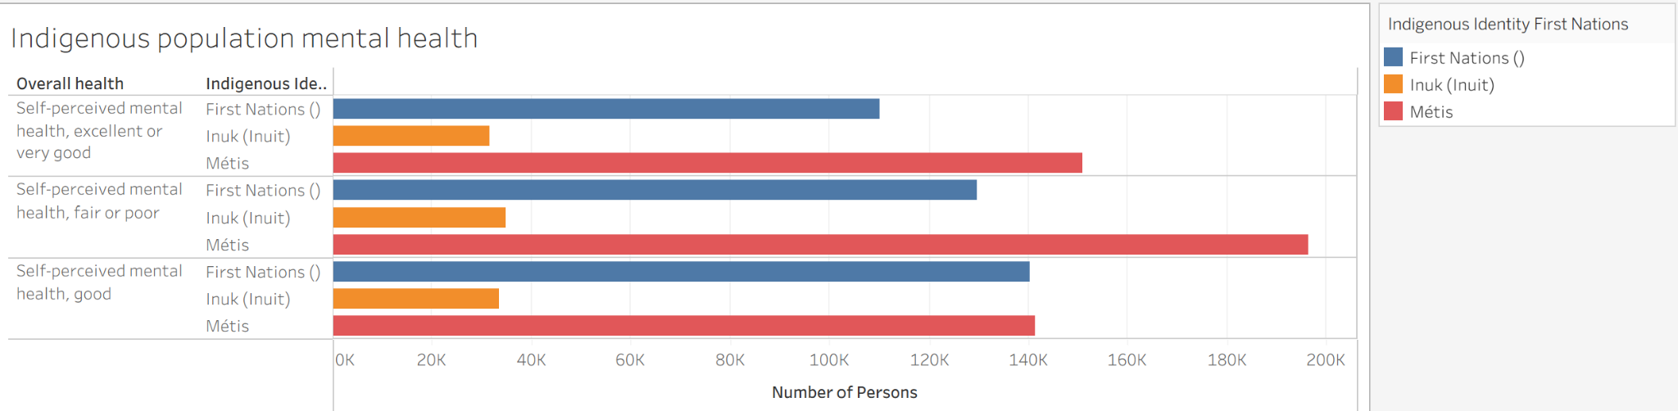
Plots
Indigenous population mental health fair or poor highest among First Nations and Metis
Focus on Metis because they have the highest mental health realted issues

Slide 5
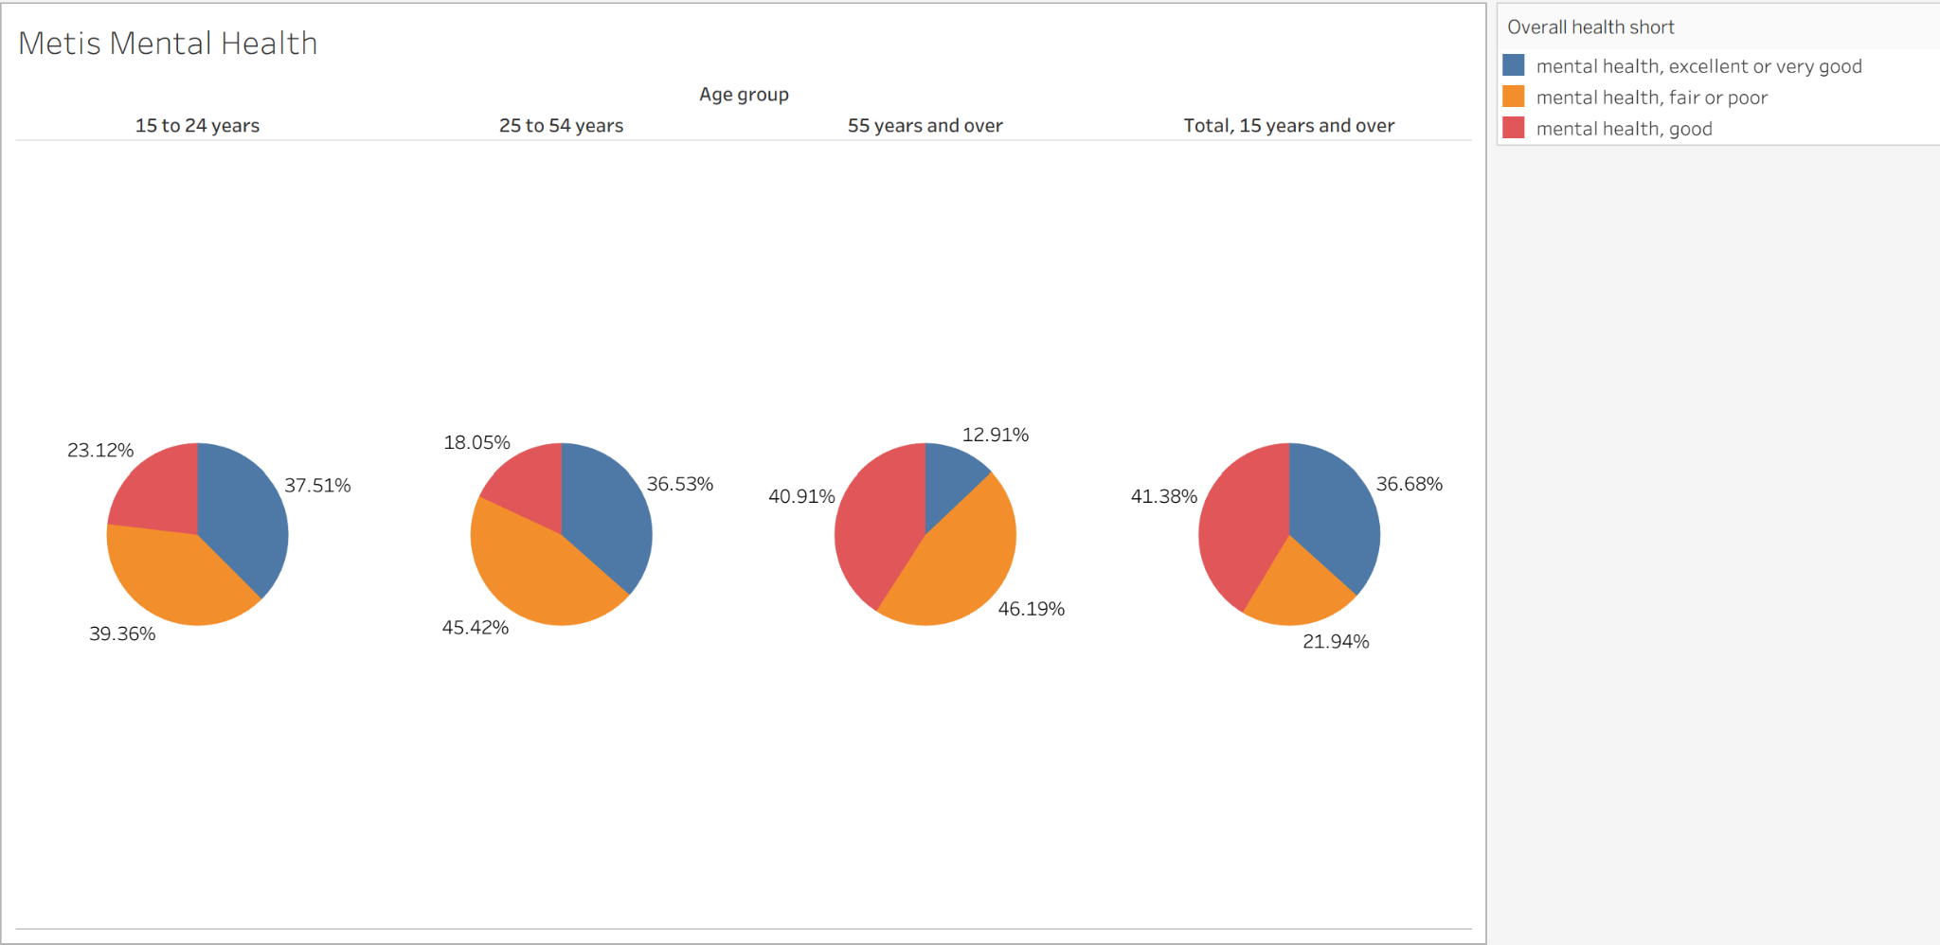
Metis Mental Health ( 25 to 54 years of age and 55 years and over)
45.42% and 46.19% of individuals have self-perceived mental health fair or poor

Slide 6
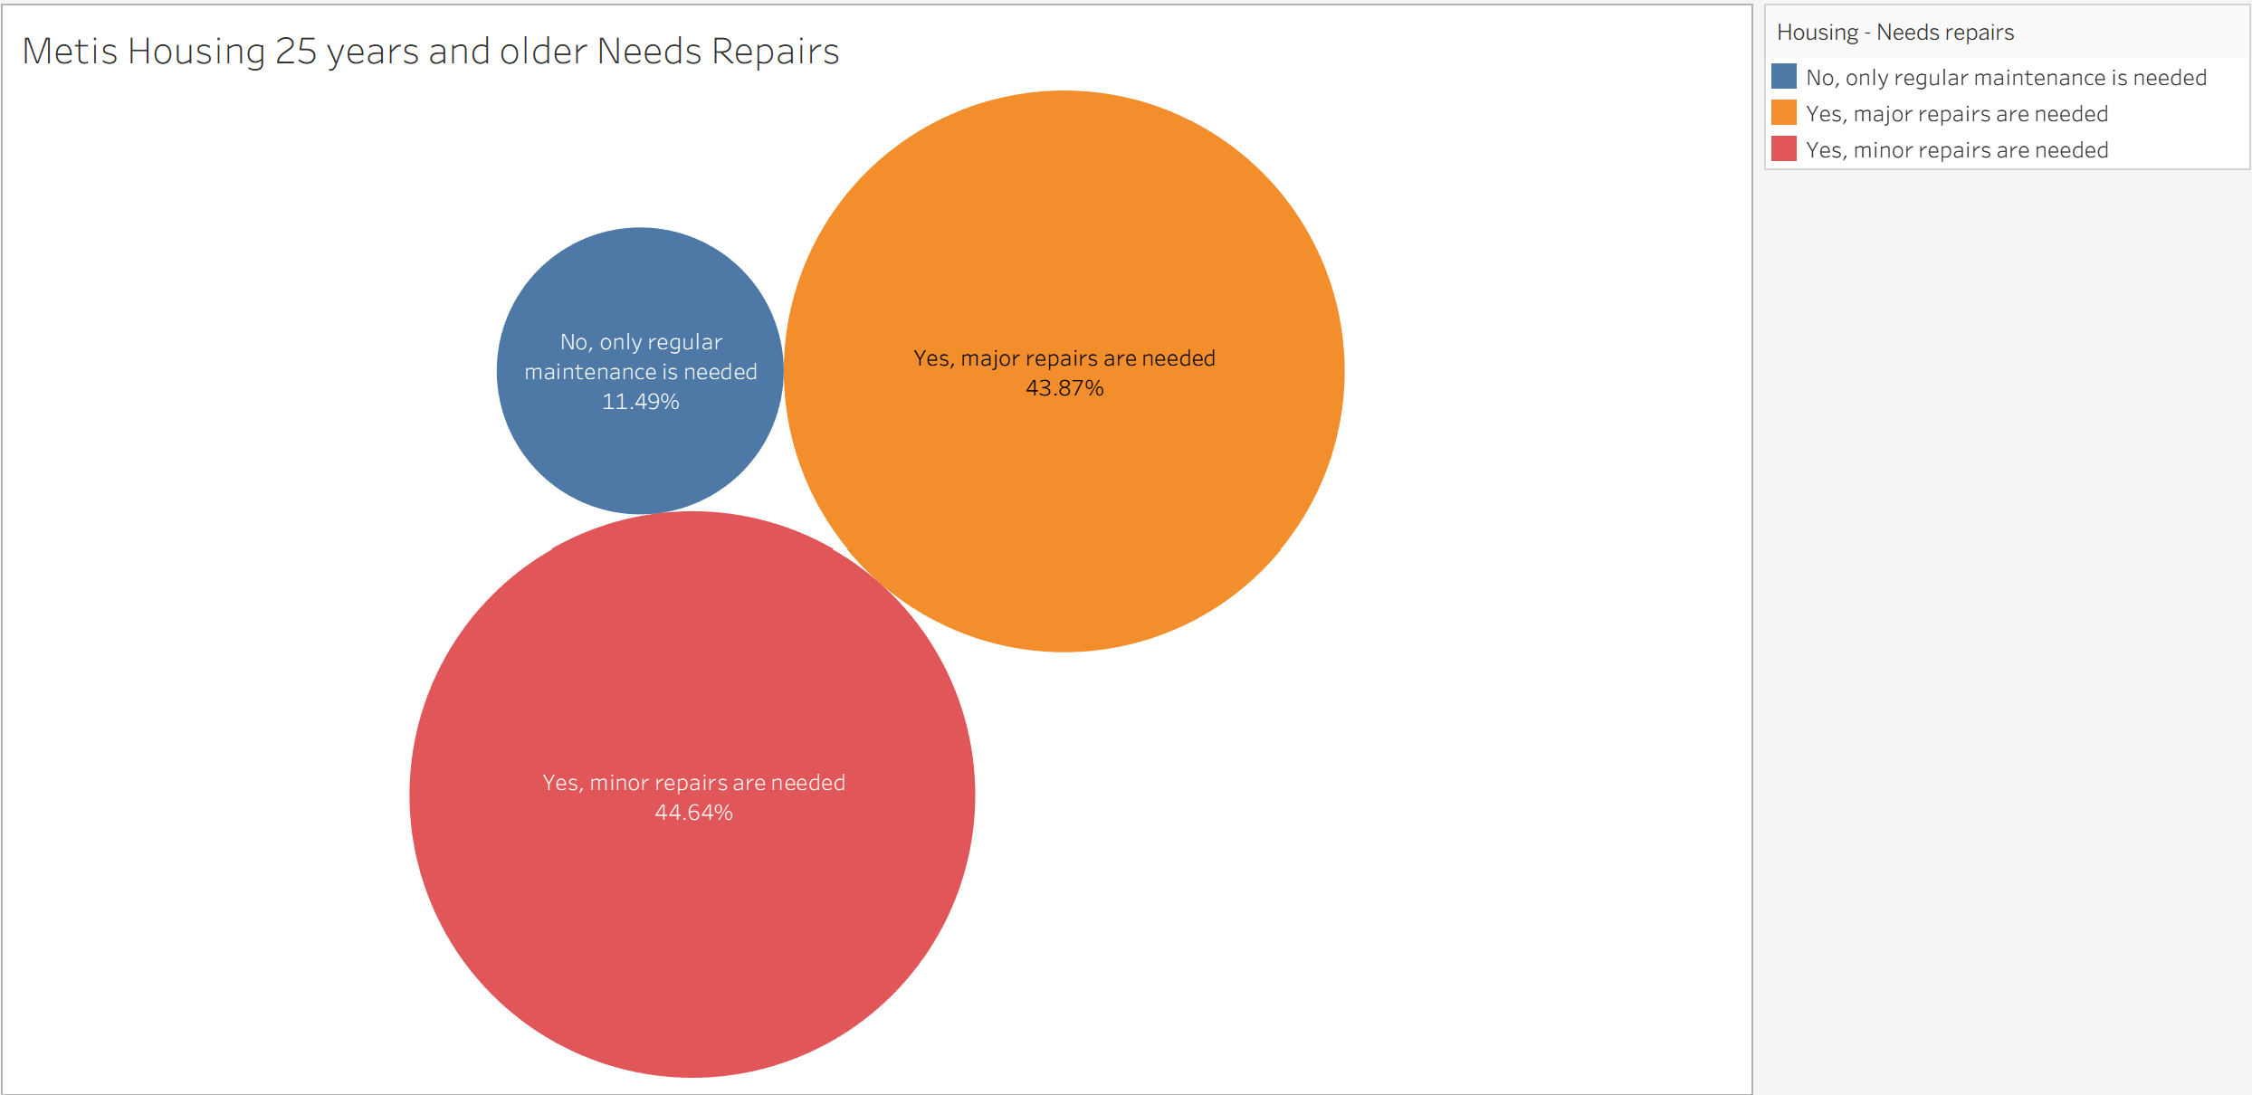
Among Metis population age group 25 and older
90% Major or minor repairs needed to houses

Slide 7
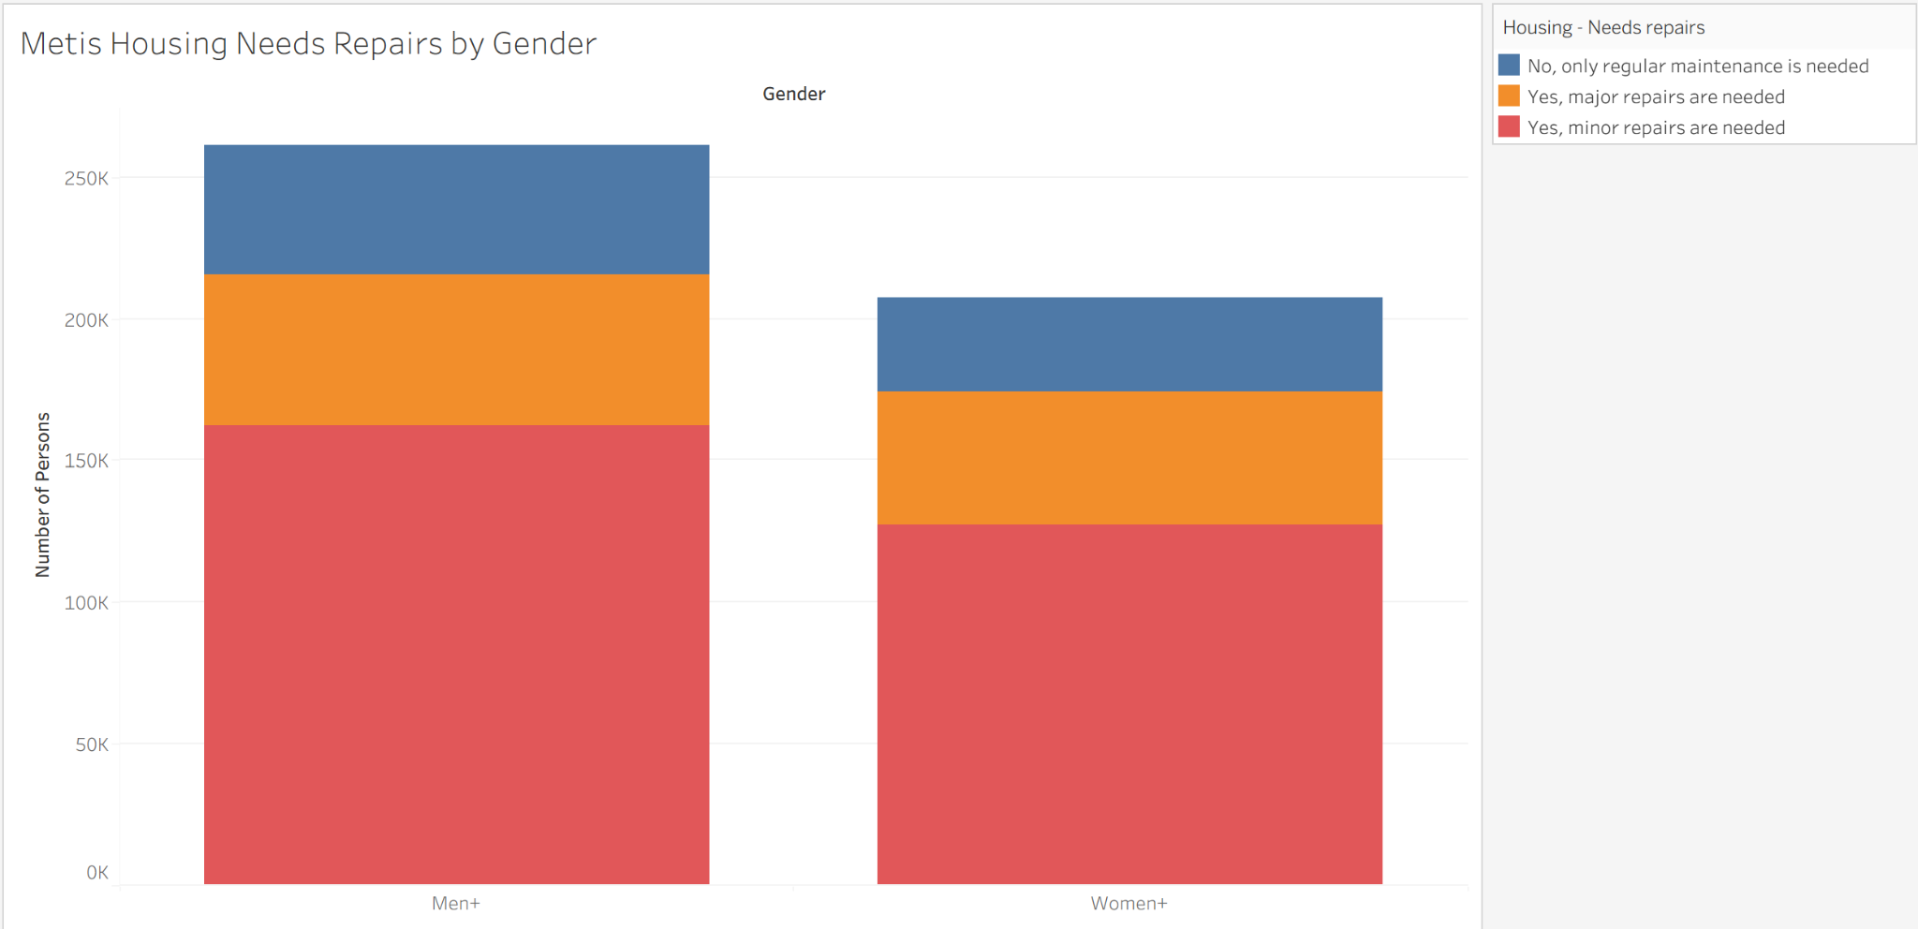
means non-binary men and women included
Men are having more major or minor repairs needed

Slide 8
Analysis and Conclusion
Metis people were found to have issues of mental health related to housing needs and within higher age groups
Residential Schools - Christian schools where First Nations were required to follow European cultures [
Assimilation of communities in Residential Schools in Canada - most are getting accommodate now in schools
Last Residential School closed in 1996 [3]
Cause of mental health concerns and related to income
$35,600 income of Metis vs Canadians $70,500 [9, 10]

Slide 9
References
[1]
https://www.metisnation.org/about-the-mno/culture-heritage/
[2] https://thecanadianencyclopedia.ca/en/timeline/the-indian-act
[3] https://thecanadianencyclopedia.ca/en/article/residential-schools
[4] https://www.rcaanc-cirnac.gc.ca/eng/1100100032275/1529354547314
[5] https://thecanadianencyclopedia.ca/en/article/aboriginal-reserves
[6] https://itk.ca/about-canadian-inuit/
[7] https://www150.statcan.gc.ca/t1/tbl1/en/tv.action?pid=981002810
[8] https://www150.statcan.gc.ca/n1/pub/11-627-m/11-627-m2024019-eng.htm1

Slide 10
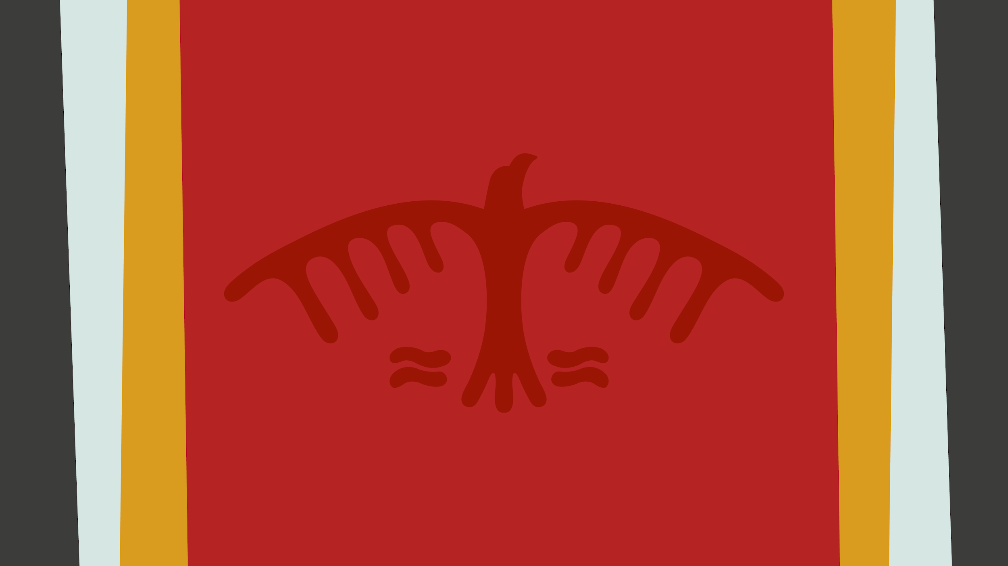
Chi-Miigwetch
Thank you

